Slide 1
COSC 2430
Lab 10/14/2019

Slide 2
Book Exercise
Goodrich, M. T., Tamassia, R., Goldwasser, M. H. Data Structures and Algorithms in Java. Wiley, 6th edition, 2016

Slide 3
Chapter 3
R-3.9 Give an implementation of the size( ) method for the SingularlyLinkedList class, assuming that we did not maintain size as an instance variable.
Public int size(){
Int count = 0;
Node<E> walk =head;
While(walk!= null){
Count++;
Walk = walk.getNext();}
Return count;
}

Slide 4
Chapter 3
R-3.10 Give an implementation of the size( ) method for the CircularlyLinkedList class, assuming that we did not maintain size as an instance variable.
Public int size(){
If (tail==null) return 0;
Node<E> walk = tail.next;
Int count = 1;
While(walk!= tail){
Count++;
Walk = walk.getNext();}
Return count;
}

Slide 5
Chapter 3
R-3.11 Give an implementation of the size( ) method for the DoublyLinkedList class, assuming that we did not maintain size as an instance variable.
Public int size(){
Int count = 0;
Node<E> walk =header.next;
While(walk!= tailer){
Count++;
Walk = walk.getNext();
}
Return count;
}

Slide 6
Chapter 4: Algorithm Analysis
R-4.1 Graph the functions 8n, 4nlogn, 2n2, n3, and 2n using a logarithmic scale for the x- and y-axes; that is, if the function value f (n) is y, plot this as a point with x-coordinate at logn and y-coordinate at logy.
Use powers of 2 as input value for n

Slide 7
Chapter 4: Algorithm Analysis
R-4.2 The number of operations executed by algorithms A and B is 8nlogn and 2n^2, respectively. Determine n0 such that A is better than B for n ≥ n0.
Set the two equations equal and simplify it:
8nlogn = 2n^2
4 log n = n => n=2^4 = 16 => cross-over occurs at n=16 . So for n>= 16 , 8nlogn is better than 2n^2.
What does better than mean here ?

Slide 8
Chapter 4: Algorithm Analysis
R-4.9 Give a big-Oh characterization, in terms of n, of the running time of the example1
method shown in Code Fragment 4.12.
R-4.10 Give a big-Oh characterization, in terms of n, of the running time of the example2
method shown in Code Fragment 4.12.
R-4.11 Give a big-Oh characterization, in terms of n, of the running time of the example3
method shown in Code Fragment 4.12.
R-4.12 Give a big-Oh characterization, in terms of n, of the running time of the example4
method shown in Code Fragment 4.12.

Slide 9
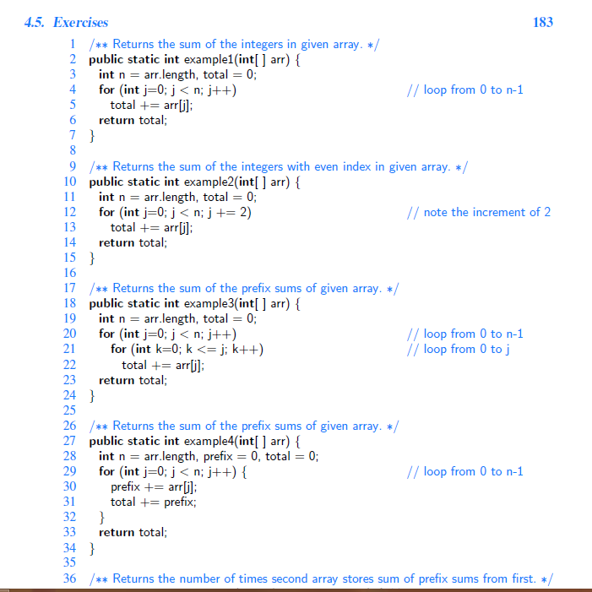
Chapter 4: Algorithm Analysis

Slide 10
Chapter 4: Algorithm Analysis
R-4.22 Show that (n+1)^5 is O(n^5).
We need to find that (n+1)^5 <= C(n)^5 for every integer n >=n0.
Since (n+1) <= 2n for n>=1 we have that
(n+1)^5<= (2n)^5=32n^5 = c(n)^5 for c =32 and n>=n0=1

Slide 11
Chapter 4: Algorithm Analysis
R-4.23 Show that 2^(n+1) is O(2^n).
We need to find that 2^(n+1) <= C (2^n) for every integer n >=n0.
We set c=2 and n0=1 since 2^(n+1) = 2 * 2^n

Slide 12
Chapter 4: Algorithm Analysis
R-4.24 Show that n is O(nlogn).
We need to find that n<= C nlogn for every integer n >=n0.
For n=1 , n > c * 1* 0 =0
But for n>=2 , n <=nlogn . So,
n<= C nlogn for c =1 and n0=2

Slide 13
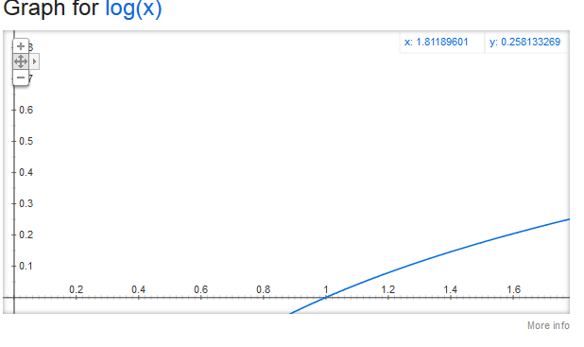
Chapter 4: Algorithm Analysis
R-4.26 Show that nlogn is Ω(n).
We need to find that nlogn >= Cn for every integer n >=n0 and c>0 and n0>=1.
Choosing c=1 and n0=2, shows nlogn >cn since logn >> 1 in this range

Slide 14
Chapter 4: Algorithm Analysis
R-4.27 Show that ⌈ f (n)⌉ is O( f (n)), if f (n) is a positive nondecreasing function that is always greater than 1.
if f (n) is a positive nondecreasing function that is always greater than 1, then ⌈ f (n)⌉ <= f (n) +1

Slide 15
Chapter 5: Recursion
R-5.2 Explain how to modify the recursive binary search algorithm so that it returns the index of the target in the sequence or −1 (if the target is not found).

Slide 16
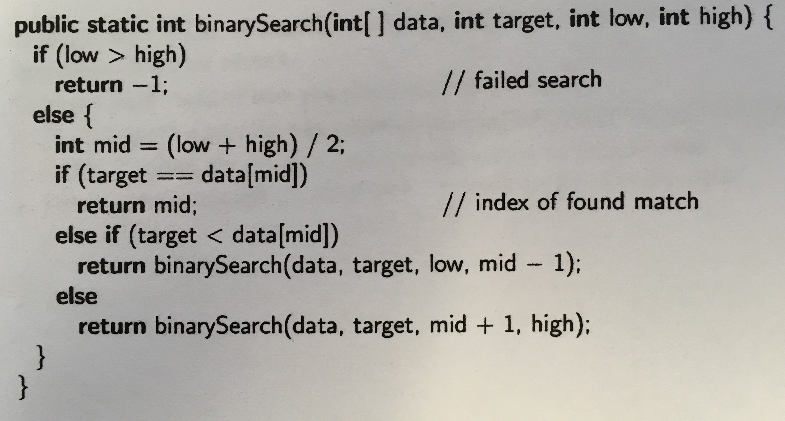
Chapter 5: Recursion
R-5.2 Explain how to modify the recursive binary search algorithm so that it returns the index of the target in the sequence or −1 (if the target is not found).

Slide 17
Chapter 5: Recursion
R-5.3 Draw the recursion trace for the computation of power(2,5), using the traditional algorithm implemented in Code Fragment 5.8.
1 /** Computes the value of x raised to the nth power, for nonnegative integer n. */
2 public static double power(double x, int n)
3 { if (n == 0)
4 return 1;
5 else
6 return x * power(x, n−1);
7 }

Slide 18
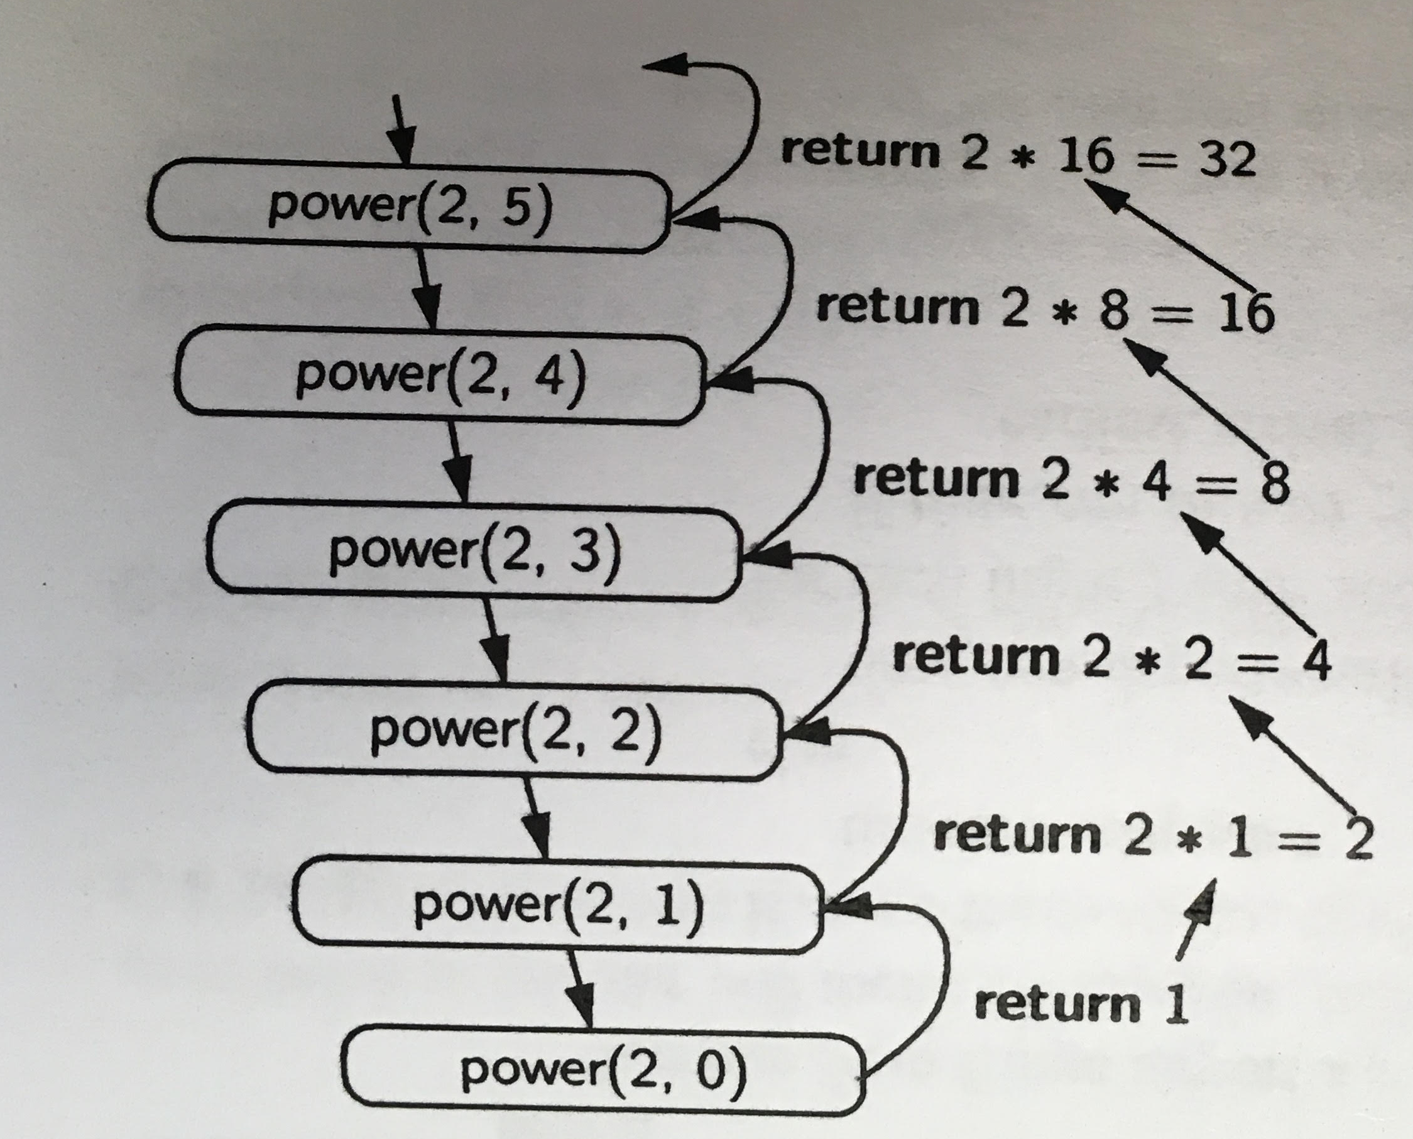
Chapter 5: Recursion
R-5.3 Draw the recursion trace for the computation of power(2,5), using the traditional algorithm implemented in Code Fragment 5.8.

Slide 19
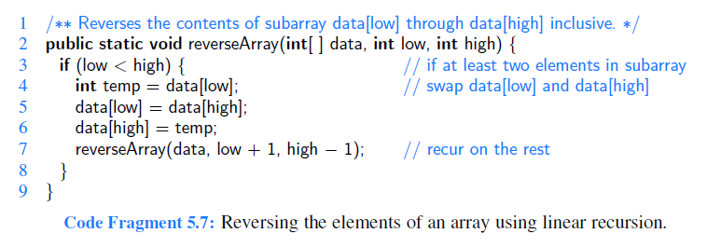
Chapter 5: Recursion
R-5.5 Draw the recursion trace for the execution of reverseArray(data, 0, 4), from Code Fragment 5.7, on array data = 4, 3, 6, 2, 5.
The first time we call reverseArray(data, 0, n−1).

Slide 20
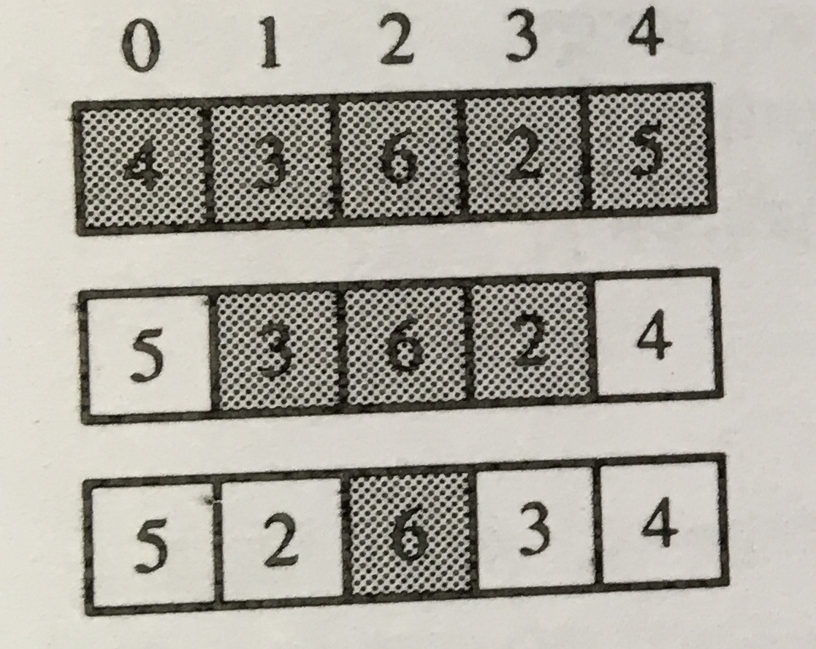
Chapter 5: Recursion
R-5.5 Draw the recursion trace for the execution of reverseArray(data, 0, 4), from Code Fragment 5.7, on array data = 4, 3, 6, 2, 5.

Slide 21
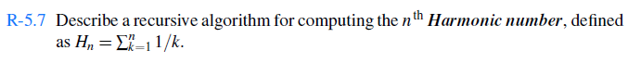
Chapter 5: Recursion
The recursion formula: H(n) = H(n-1) + 1/n
Double Harmonic_num(int n)
{
If (n==1)
Return 1;
Return Harmonic_num(n-1) + 1/n
}

Slide 22
Chapter 5: Recursion
R-5.8 Describe a recursive algorithm for converting a string of digits into the integer it represents. For example, '13531' represents the integer 13,531.
Let s’ = sd for digit d. We have that
Value(s’) = d+ 10 * Value(s)
//n: size of string
Int Convert(string s, int n)
{
if (n==1)
return Integer.parseInt(s);
else
{
d = Integer.parseInt(s[n-1] );
return d + 10*convert(s,n-1)
}

Slide 23
Chapter 5: Recursion
C-5.20 Write a short recursive Java method that rearranges an array of integer values so that all the even values appear before all the odd values.

Slide 24
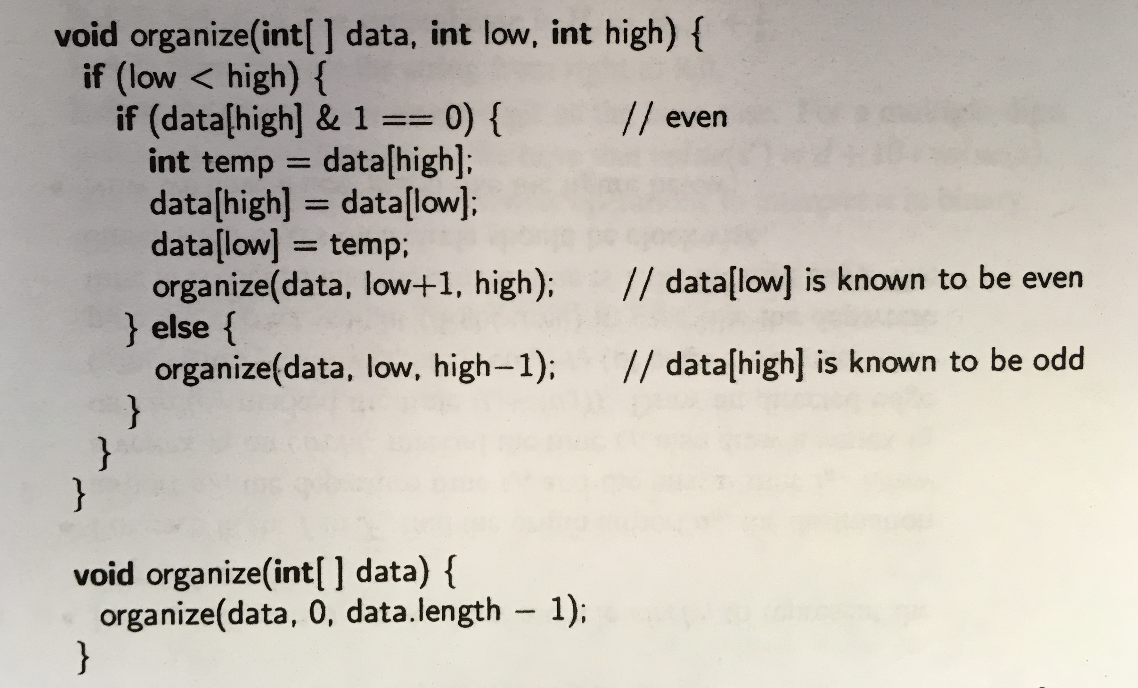
Chapter 5: Recursion
& : Bitwise AND
5= 0101
1= 0001
5 & 1 = 0001 => 5 is odd
4= 0100
1= 0001
4 & 1 = 0000 => 4 is even

